Slide 1
Progress of Week2, August
OUTLINE
Detailed Comparison between MPC_GT and MSC of one day’s opt
Price_DC and MPC_GT Performance
2. Sensitive Tests

Slide 2
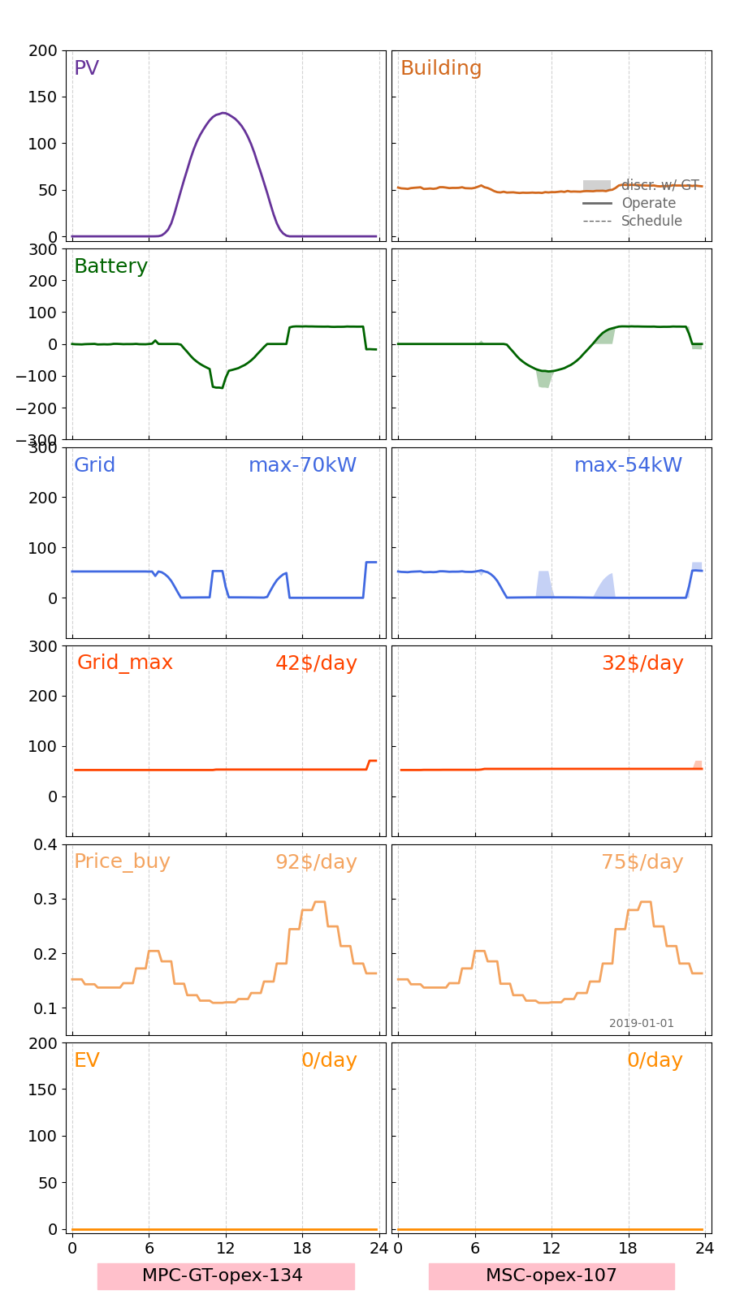
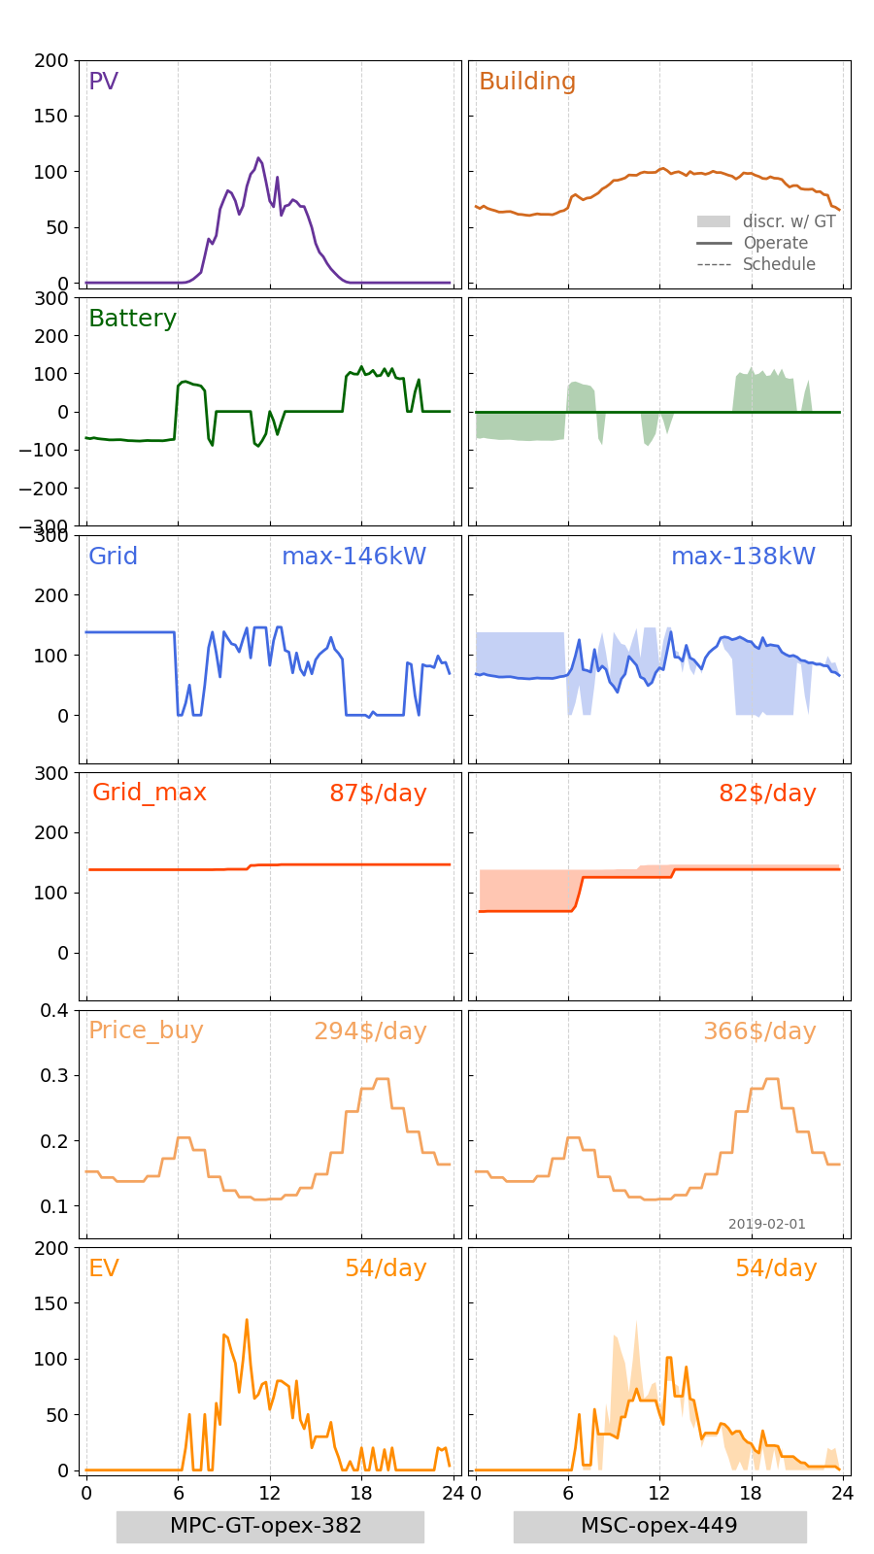
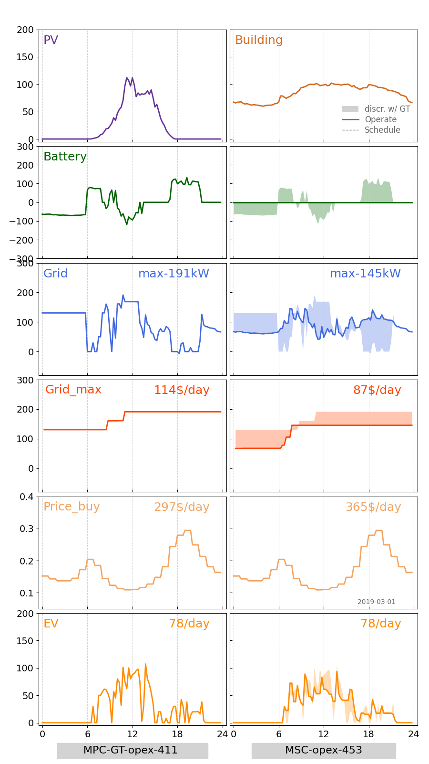
1. Detailed Comparison between MPC_GT and MSC of one day’s opt
-1.1 Jan-Mar
Jan-1
Feb-1
Mar-1

Slide 3
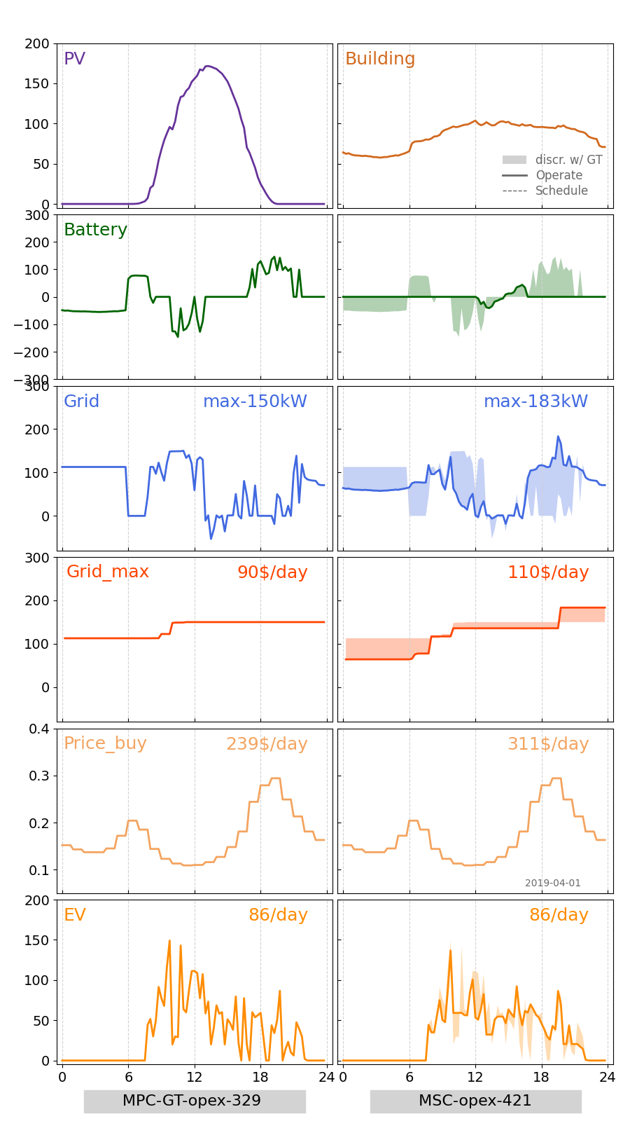
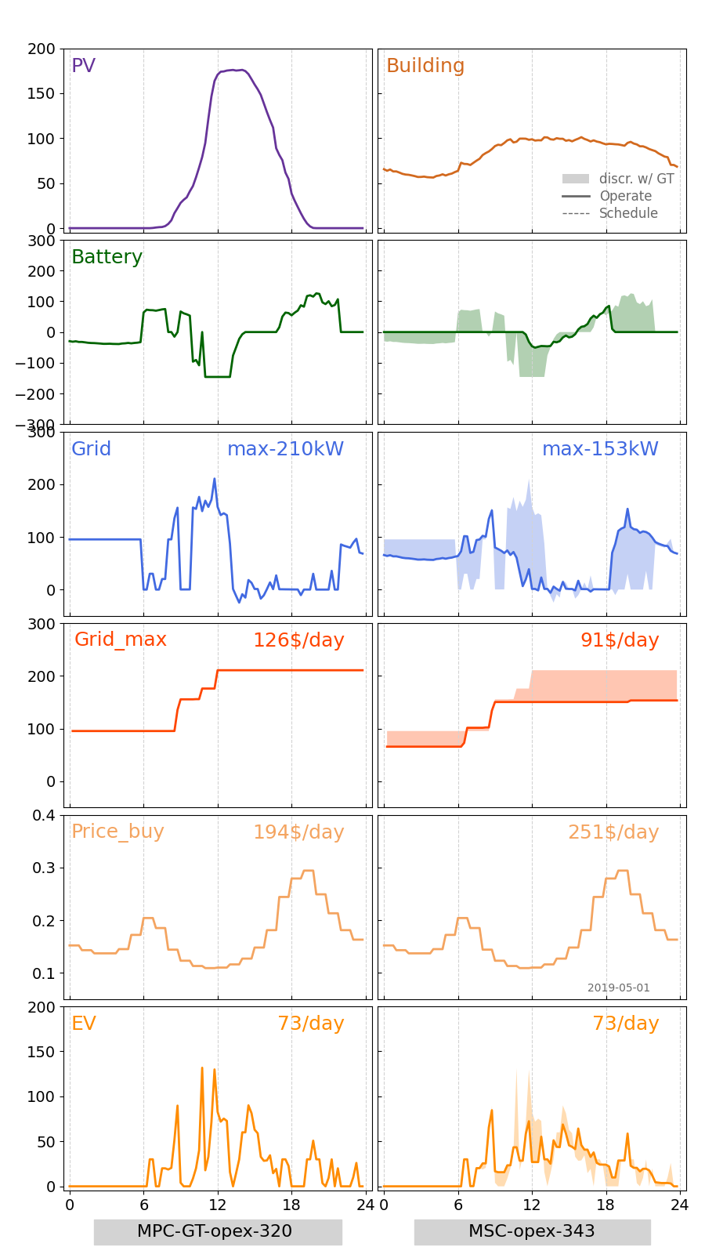
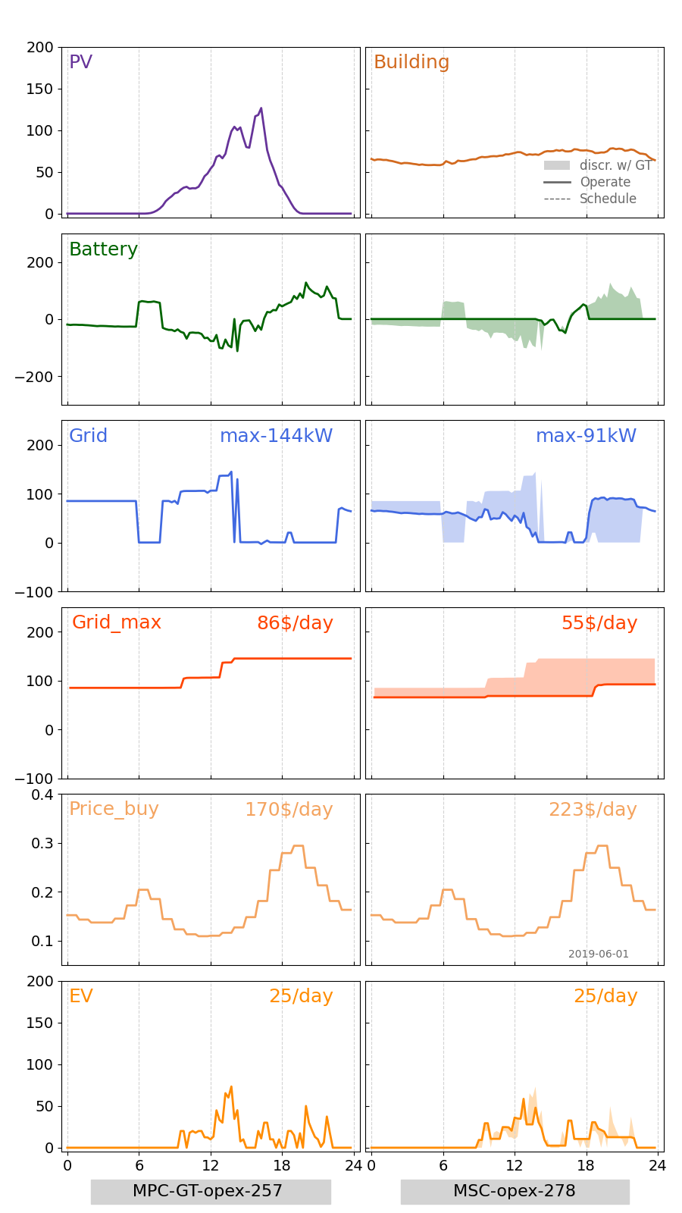
1. Detailed Comparison between MPC_GT and MSC of one day’s opt
-1.2 Jan-Mar
Apr-1
May-1
Jun-1

Slide 4
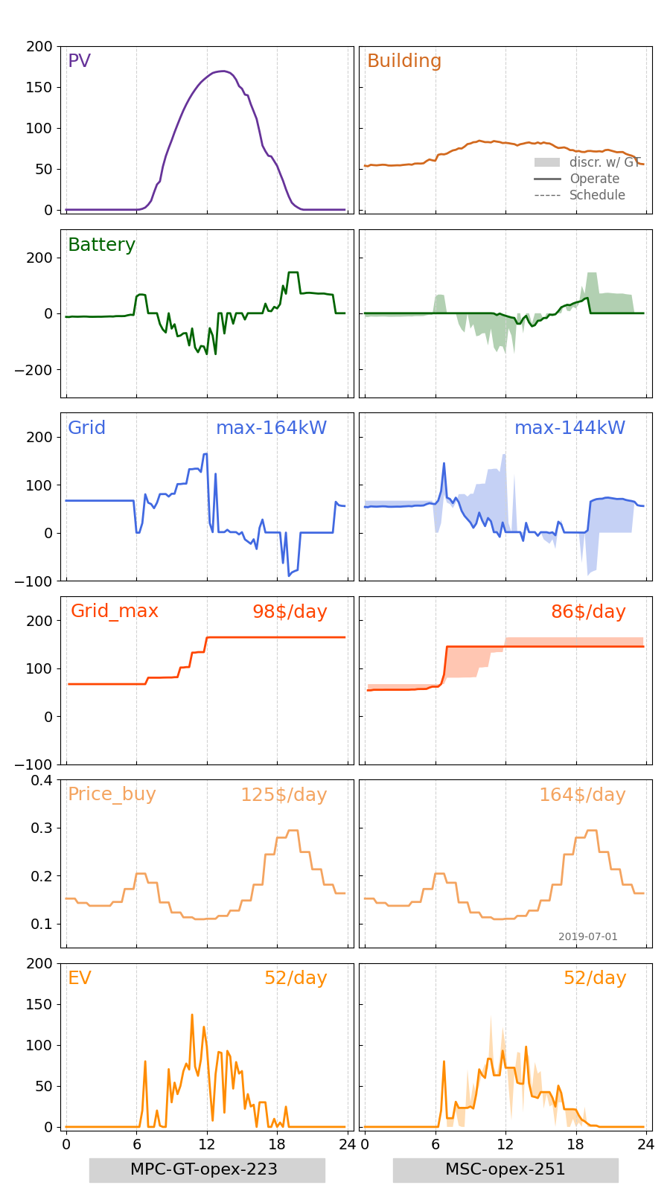
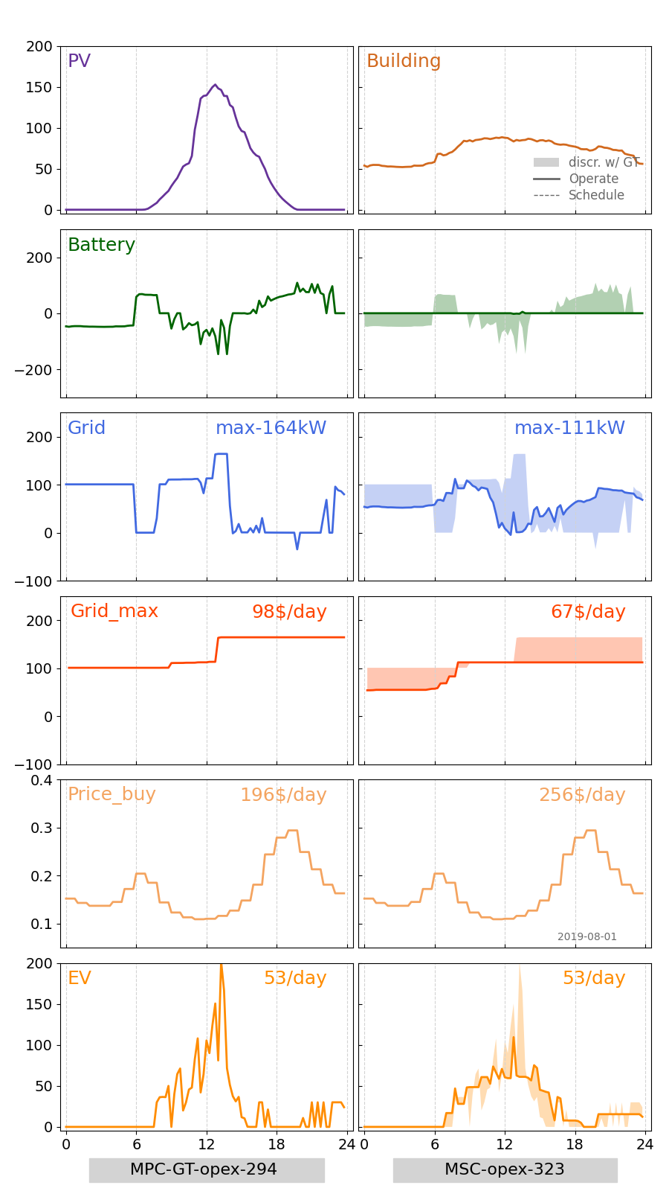
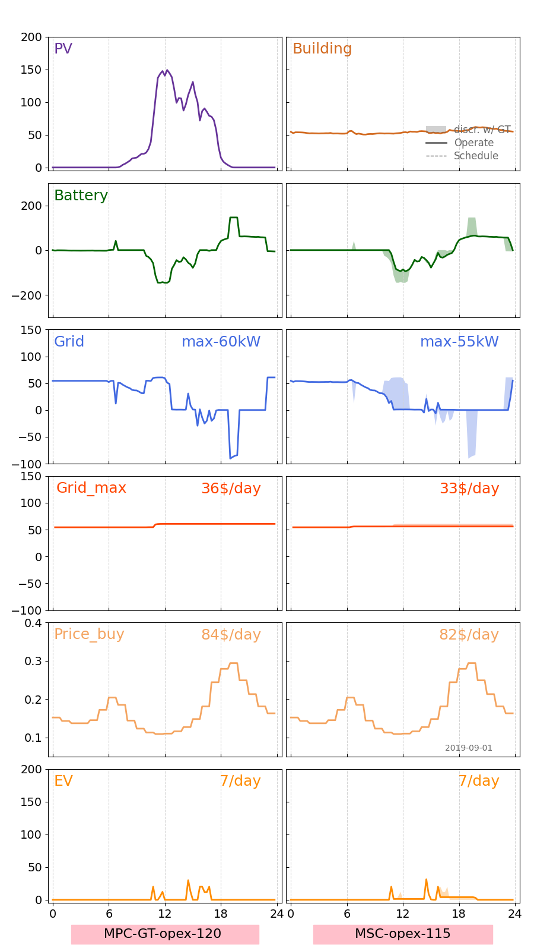
1. Detailed Comparison between MPC_GT and MSC of one day’s opt
-1.3 Jul-Sep
Jul-1
Aug-1
Sep-1

Slide 5
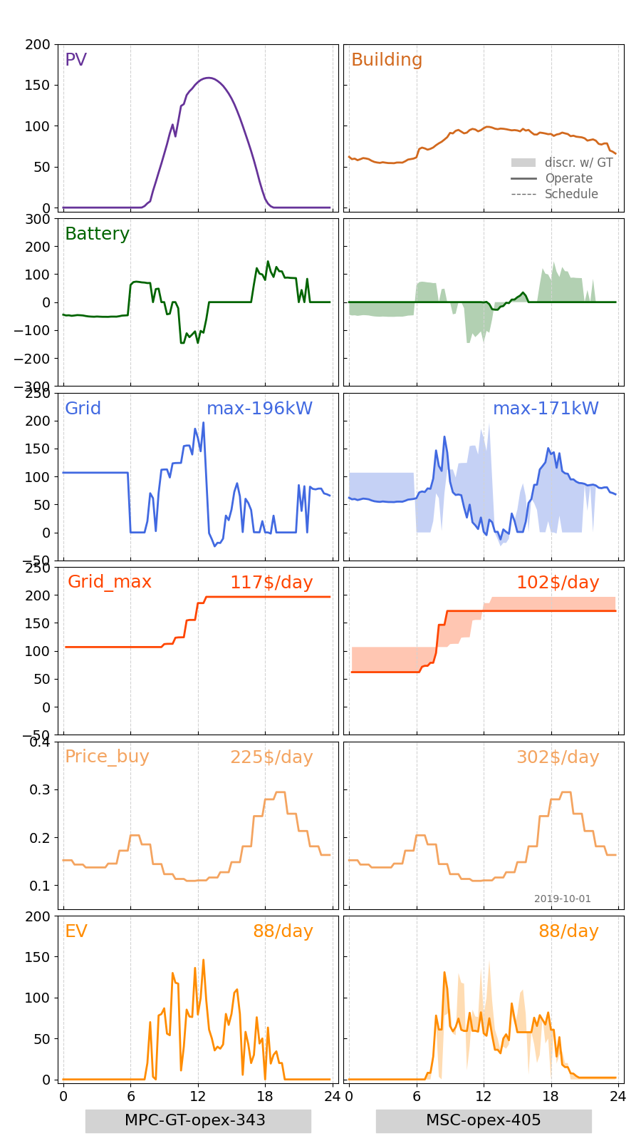
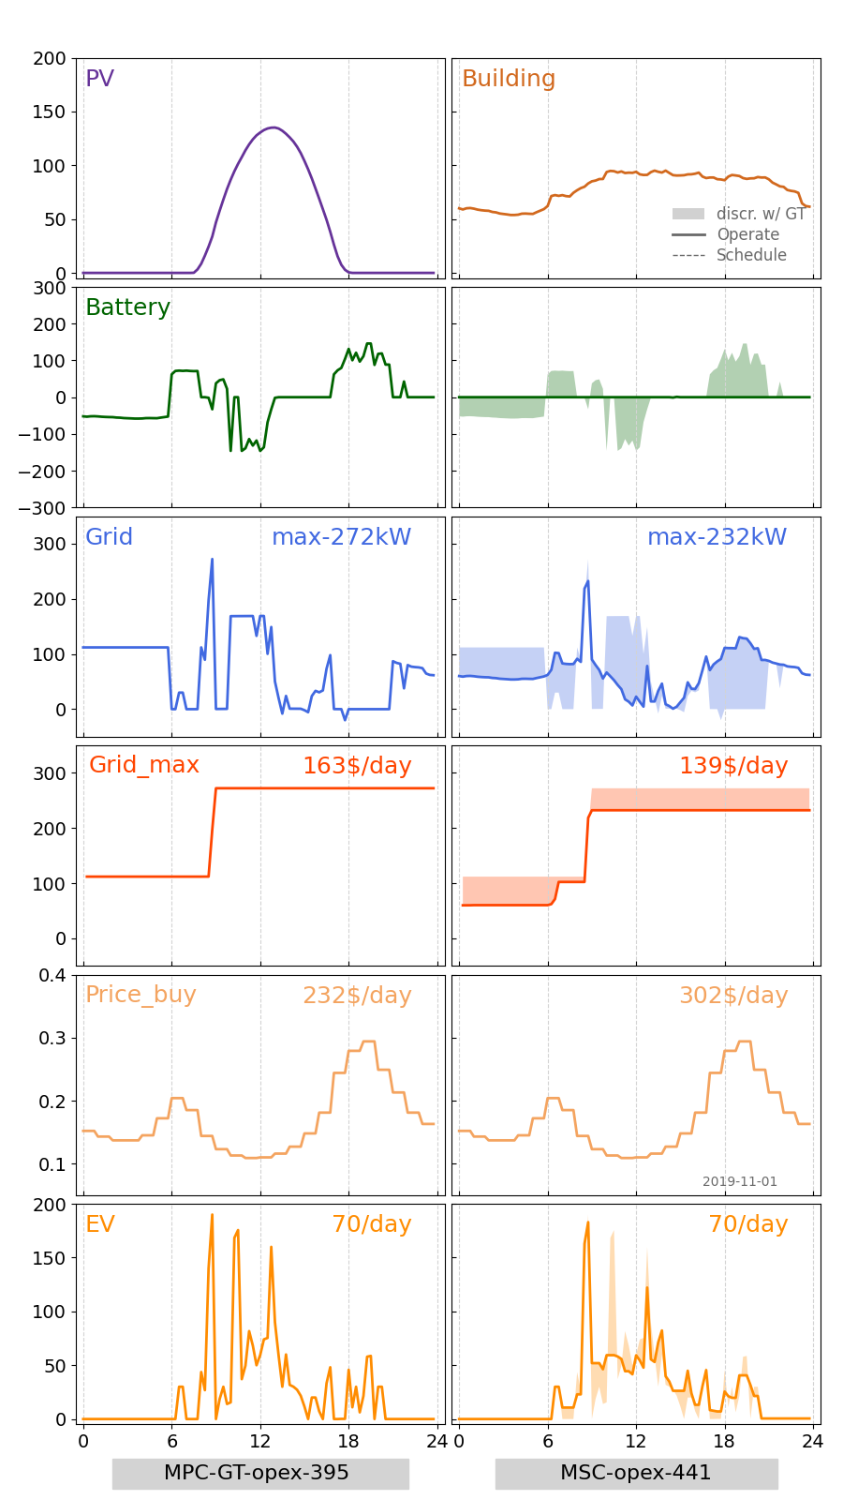
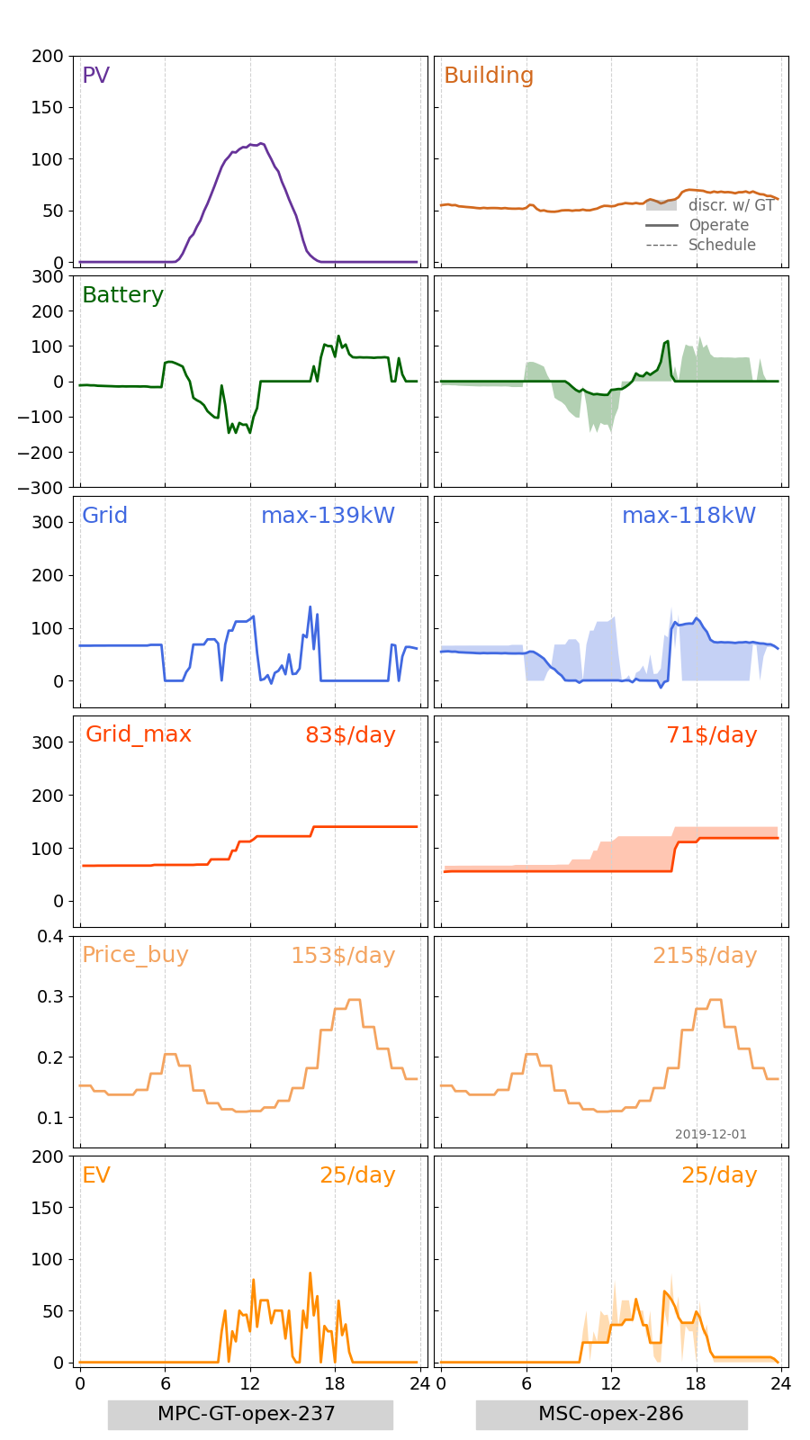
1. Detailed Comparison between MPC_GT and MSC of one day’s opt
-1.4 Oct-Dec
Oct-1
Nov-1
Dec-1

Slide 6
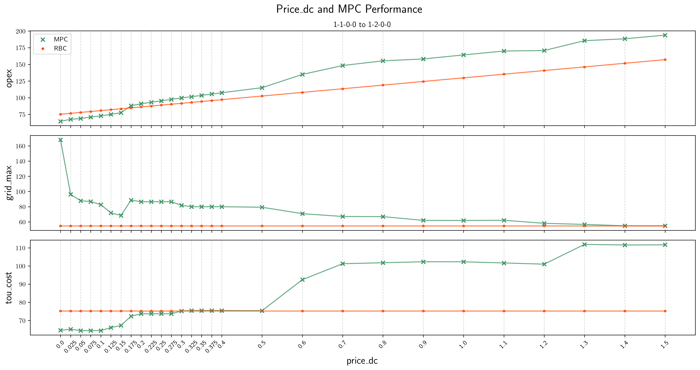
2. Price_DC and MPC_GT Performance
-2.1 Jan-1 EV: 0/day
Oct-1
Nov-1
Dec-1

Slide 7
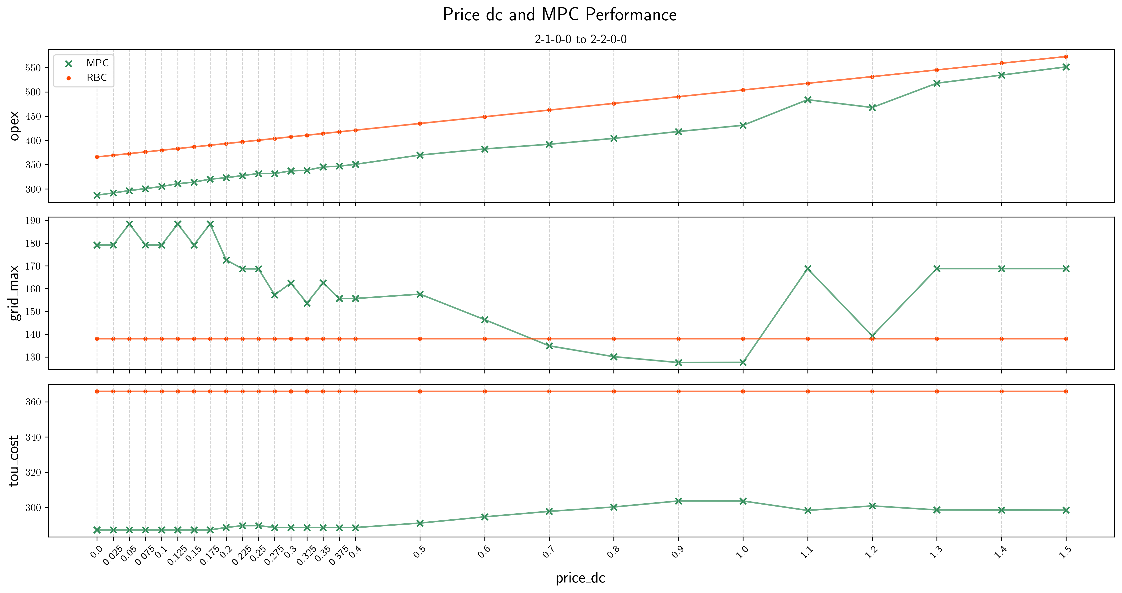
2. Price_DC and MPC_GT Performance
-2.2 Feb-1 EV: 54/day
Oct-1
Nov-1
Dec-1

Slide 8
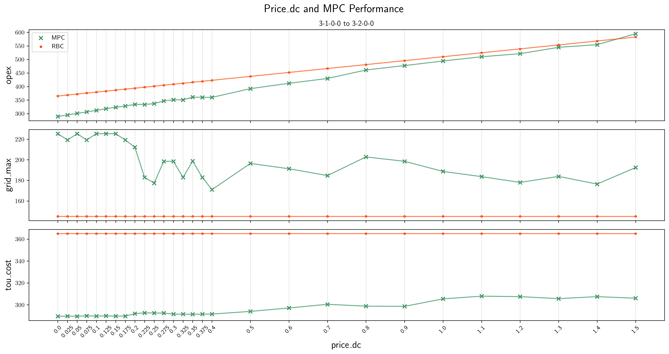
2. Price_DC and MPC_GT Performance
-2.3 Mar-1 EV: 78/day
Oct-1
Nov-1
Dec-1

Slide 9
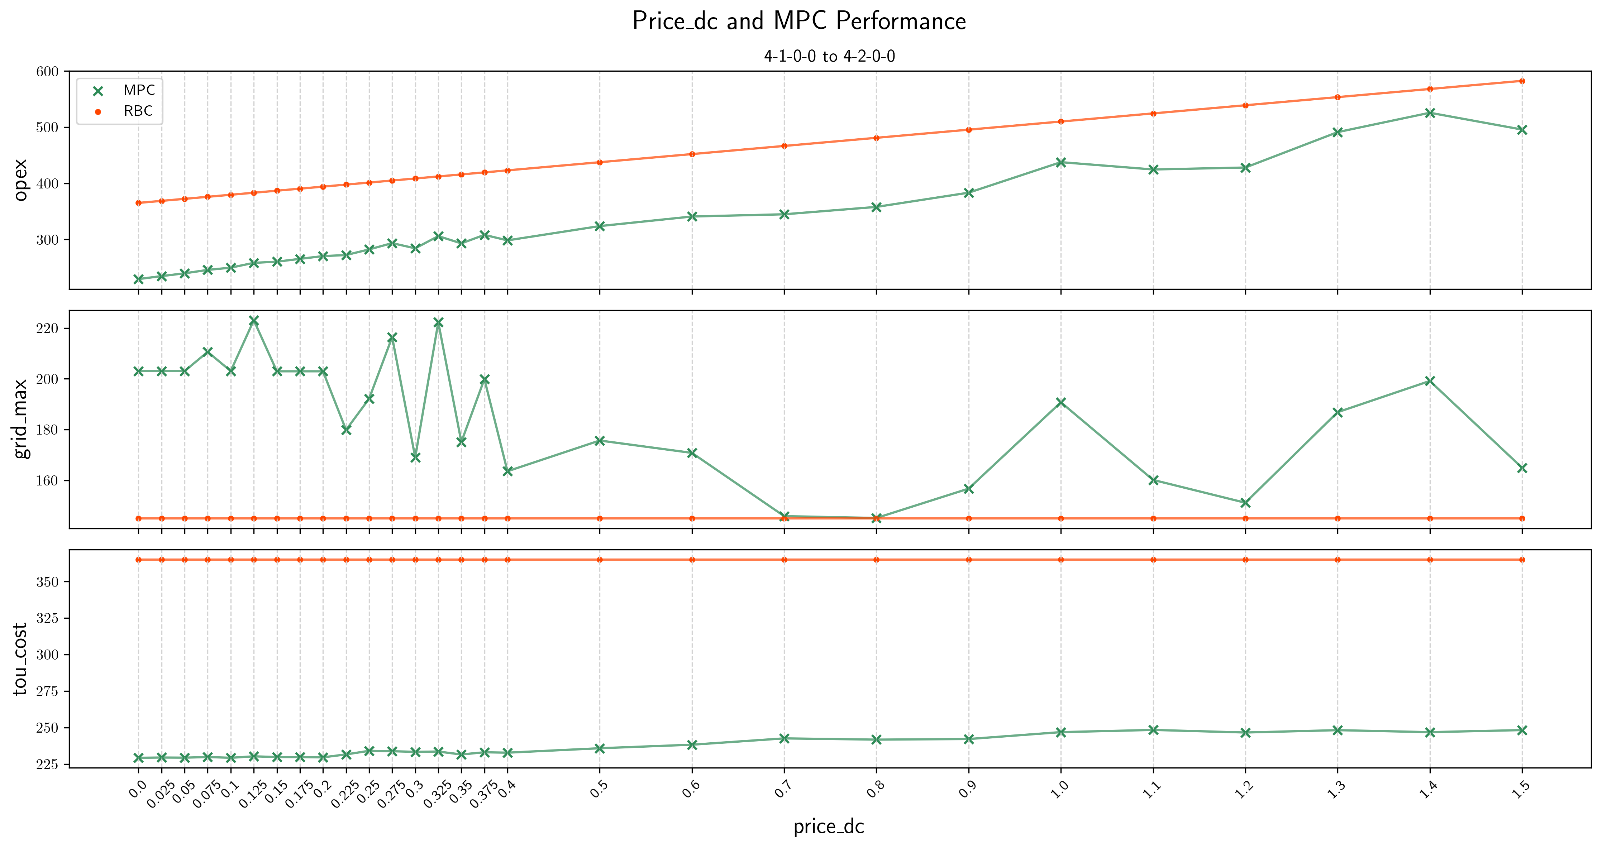
2. Price_DC and MPC_GT Performance
-2.4 Apr-1 EV: 86/day
Oct-1
Nov-1
Dec-1

Slide 10
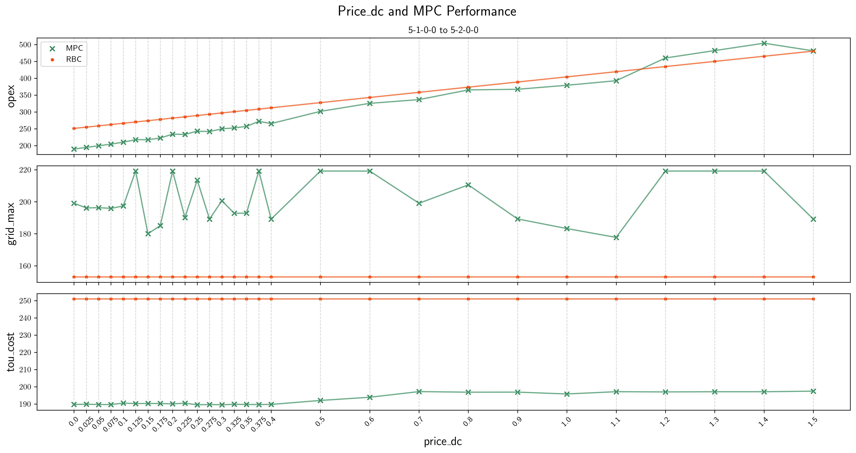
2. Price_DC and MPC_GT Performance
-2.5 May-1 EV: 73/day
Oct-1
Nov-1
Dec-1

Slide 11

2. Price_DC and MPC_GT Performance
-2.6 Jun-1 EV: 25/day
Oct-1
Nov-1
Dec-1

Slide 12
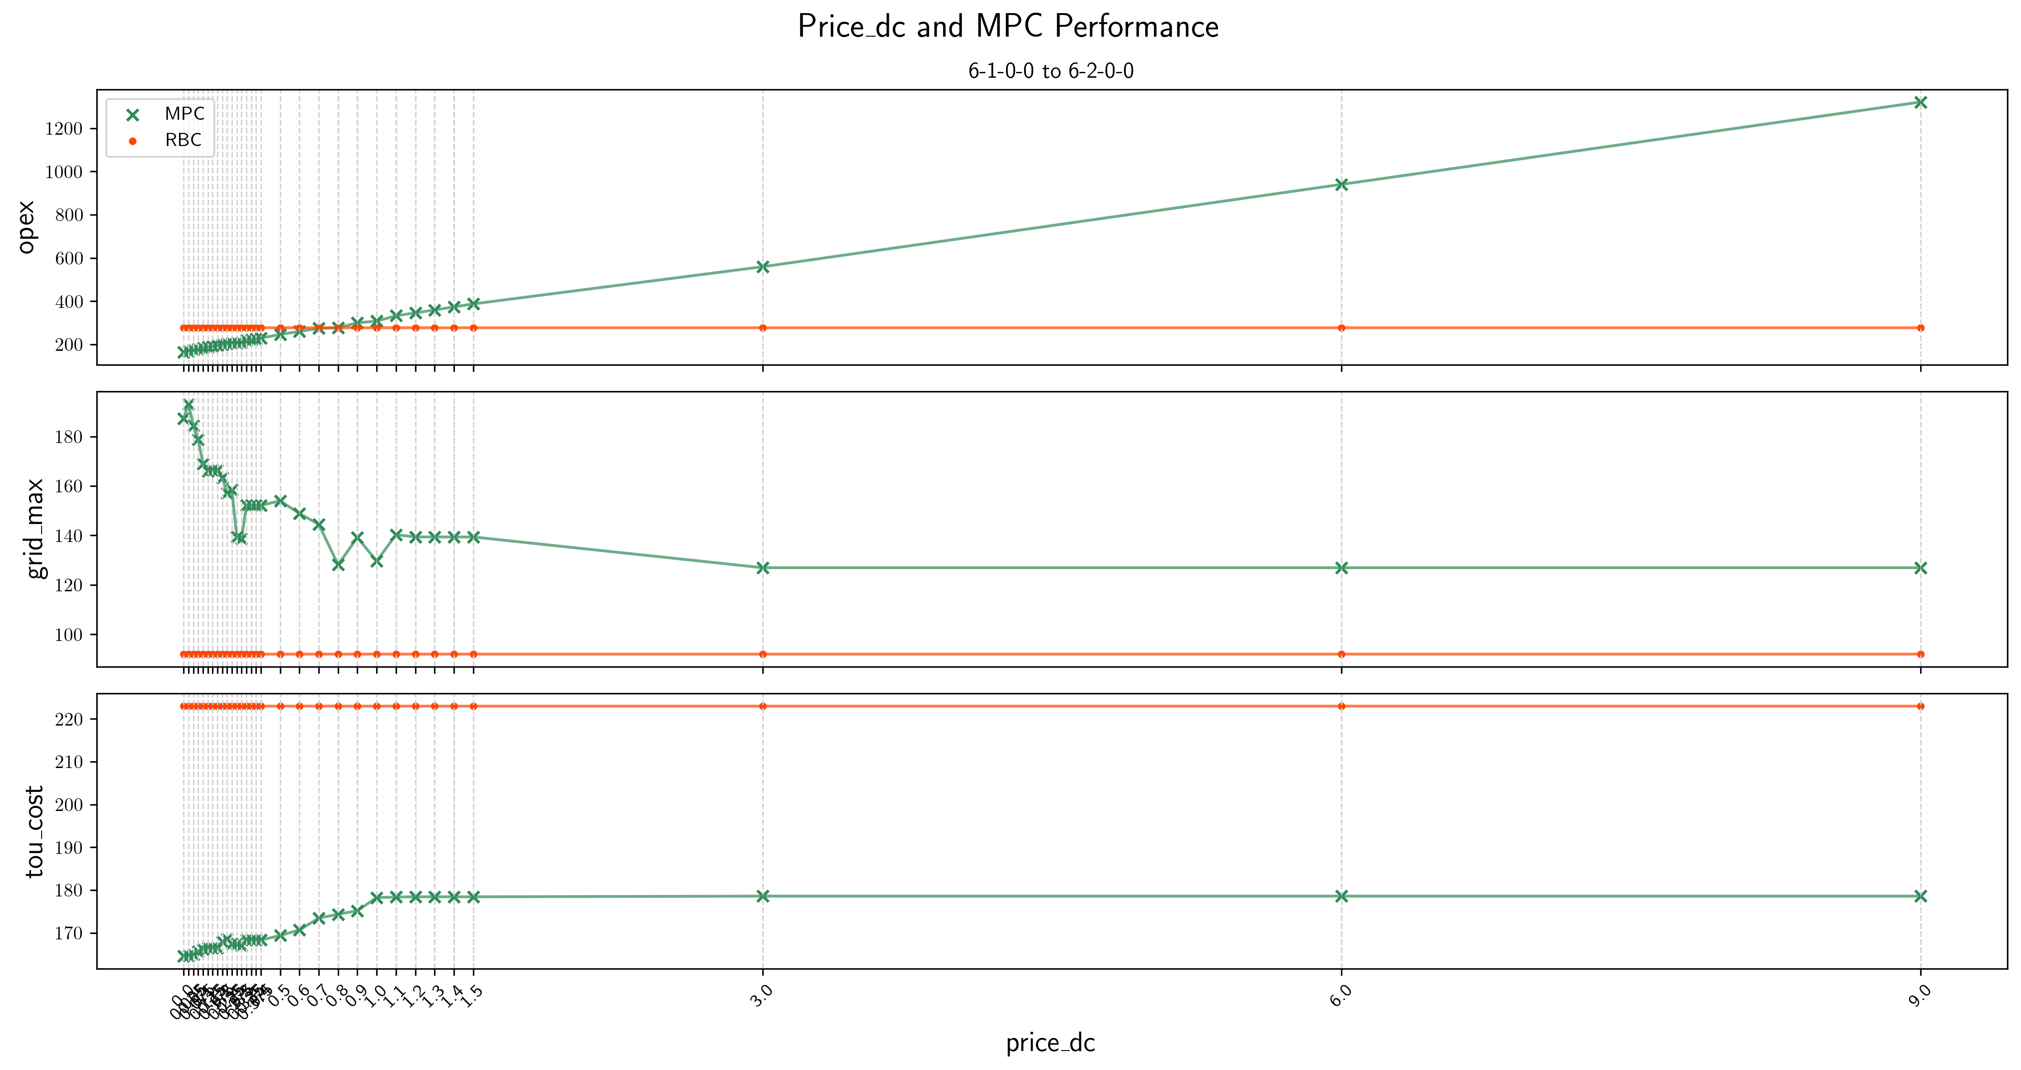
2. Price_DC and MPC_GT Performance
-2.6 Jun-1-large scale
Oct-1
Nov-1
Dec-1

